Slide 1

Java Programming Essentials: A Comprehensive Journey into Core Java and Beyond
- Bharath Ashok

Slide 2

Day 10

Slide 3
Day 10: Agenda
Collections Framework
List Interface
List Implementation Classes
Set and Implementation Classes
Hands-on
Assignments
Interview Questions

Slide 4
Collection Framework

Slide 5
Introduction to Java Collections
Definition of Collections
Benefits of using Collections in Java
Overview of the Java Collections Framework

Slide 6
Basics of Collection
In Java, a collection refers to a framework or a group of classes and interfaces that are used to store, manage, and manipulate groups of objects.
Collections provide a way to work with groups of elements in a unified manner, allowing developers to easily add, remove, search, and manipulate elements without having to worry about low-level details of data storage and retrieval.
Benefits of Using Collections in Java:
Dynamic Sizing: Collections allow you to store and manage a varying number of elements. They automatically resize themselves as elements are added or removed.
Efficient Data Manipulation: Collections provide efficient algorithms for various operations such as adding, removing, searching, and sorting elements, making it easier to work with groups of data.
Type Safety: Generics in the Java Collections Framework ensure type safety by enabling you to specify the type of elements stored in a collection. This helps catch type-related errors at compile time.
Reusability: Collections provide reusable data structures and algorithms that are implemented in a consistent and reliable manner. Developers can use these pre-built components to avoid reinventing the wheel.
Concurrent Access: Some collections offer thread-safe mechanisms for concurrent access, allowing multiple threads to manipulate the same collection without causing data corruption or inconsistencies.
Flexibility: The Java Collections Framework includes a wide range of collection classes, each designed for specific use cases. This gives developers the flexibility to choose the appropriate collection type based on their needs.

Slide 7
Overview of the Java Collections Framework
The Java Collections Framework is a comprehensive set of classes and interfaces that provide various types of collection implementations.
It is part of the java.util package and consists of the following main components:
Interfaces
Collection: The root interface that defines common methods for all collection types, including adding, removing, and iterating over elements.
List: An ordered collection that allows duplicate elements and provides access by index.
Set: A collection that does not allow duplicate elements.
Queue: A collection used for holding elements prior to processing, often following a specific order.
Classes
ArrayList, LinkedList: Implementations of the List interface using dynamic arrays and linked lists, respectively.
HashSet, LinkedHashSet, TreeSet: Implementations of the Set interface using hash tables and trees.
PriorityQueue: An implementation of the Queue interface that provides priority-based processing.
HashMap, LinkedHashMap, TreeMap: Implementations of the Map interface using hash tables and trees for key-value mappings.
Utility Classes
Collections: Contains static methods for various collection-related operations like sorting, searching, and synchronizing collections.

Slide 8
Collection Classes Hierarchy
ArrayList, LinkedList, HashSet, TreeSet, PriorityQueue, HashMap, TreeMap, etc.
Understanding the relationships between classes

Slide 9
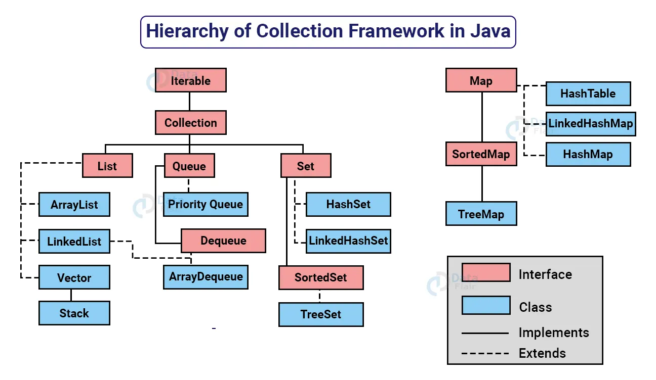
Collection Classes Hierarchy
Collection
The root interface for all collection types. It defines common methods for adding, removing, iterating, and querying elements.
List: An ordered collection that allows duplicate elements and provides access by index.
ArrayList: Implements a dynamic array for storing elements.
LinkedList: Implements a doubly-linked list for storing elements.
Set: A collection that does not allow duplicate elements.
HashSet: Implements a hash table for storing elements with no guaranteed order.
LinkedHashSet: Extends HashSet and maintains the order of insertion.
TreeSet: Implements a red-black tree for storing elements in sorted order.
Queue: A collection used for holding elements prior to processing.
LinkedList: Can be used as a queue or a double-ended queue (deque).
PriorityQueue: Implements a priority queue using a heap data structure.
Map: Represents key-value pairs. It maps keys to values and does not allow duplicate keys.
HashMap: Implements a hash table for key-value storage with no guaranteed order.
LinkedHashMap: Extends HashMap and maintains the order of insertion.
TreeMap: Implements a red-black tree for storing key-value pairs in sorted order.

Slide 10
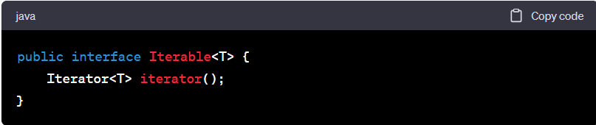
Iterable Interface
The Iterable interface is part of the java.lang package
Many classes in the Java Collections Framework implement the Iterable interface, including ArrayList, LinkedList, HashSet, TreeSet, and more.
This allows these collections to be used directly in foreach loops
Three main methods of the Iterator interface: hasNext(), next(), and remove().

Slide 11
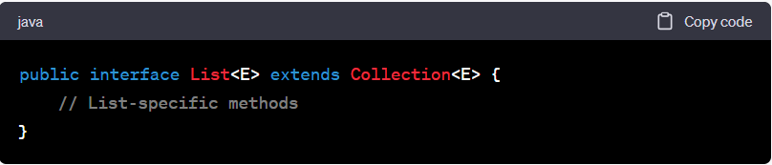
Lists in Java Collections
Introduction to Lists
ArrayList: Creation, manipulation, and common operations

Slide 12
List Interface
Ordered Collection:
Lists maintain the order in which elements are inserted. This means that you can retrieve elements from a list in the same order they were added.
Duplicates Allowed:
Unlike some other collection types, lists allow duplicate elements. Elements can appear in a list multiple times.
Common Methods:
The List interface inherits methods from the Collection interface, such as add(), remove(), contains(), and others.
List-Specific Methods:
The List interface introduces several methods specific to lists, including:
get(int index): Retrieves the element at the specified index.
set(int index, E element): Replaces the element at the specified index with the given element.
add(int index, E element): Inserts the element at the specified index, shifting subsequent elements to the right.
remove(int index): Removes the element at the specified index and shifts subsequent elements to the left.
indexOf(Object o) and lastIndexOf(Object o): Return the index of the first and last occurrence of the specified element.
subList(int fromIndex, int toIndex): Returns a view of the portion of the list between the specified indices.

Slide 13
Common Implementations Of List Interface
Java provides several classes that implement the List interface:
ArrayList: A dynamic array that provides fast random access and dynamic resizing.
LinkedList: A doubly-linked list that provides efficient insertion and deletion operations.
Vector: Similar to ArrayList, but synchronized (not recommended in favor of ArrayList).
Stack: A subclass of Vector that represents a last-in, first-out (LIFO) stack.

Slide 14
List Interface
In Java, a list is a collection that maintains an ordered sequence of elements.
Elements can be accessed by their index, and a list allows duplicates.
The List interface in the Java Collections Framework defines the common methods for working with lists.
There are several classes that implement the List interface, including the ArrayList class.
ArrayList: Creation, Manipulation, and Common Operations:
Creation: You can create an ArrayList instance using its constructor. You need to provide the type of elements the list will hold within the angle brackets (<>).
Example:
import java.util.ArrayList;
// Creating an ArrayList of Strings
ArrayList<String> stringList = new ArrayList<>();

Slide 15
ArrayList

Slide 16
Java.util.ArrayList
The ArrayList class in Java is an implementation of the List interface, which is a part of the Java Collections Framework.
ArrayList is a dynamic array-based data structure that provides resizable arrays with constant-time random access and efficient element insertion/removal.

Slide 17
Java.util.ArrayList
Implementation:
ArrayList is implemented as a resizable array that grows or shrinks automatically as elements are added or removed. It is based on the concept of a dynamically allocated array.
Ordered Collection:
Like all classes implementing the List interface, ArrayList maintains the order of elements in which they were added.
Dynamic Sizing:
One of the main advantages of ArrayList is its dynamic resizing feature. As elements are added, the underlying array grows to accommodate them. Similarly, if elements are removed, the array shrinks.
Random Access:
ArrayList provides fast and constant-time random access to elements. You can access elements directly using their index, similar to arrays.
Duplicates Allowed:
ArrayList allows duplicate elements. Elements can appear multiple times in the list.

Slide 18
Java.util.ArrayList
Common Methods:
ArrayList inherits methods from the List interface and also includes methods from the Collection interface.
Some commonly used methods include:
add(E element): Adds the element to the end of the list.
get(int index): Retrieves the element at the specified index.
set(int index, E element): Replaces the element at the specified index.
remove(int index): Removes the element at the specified index.
size(): Returns the number of elements in the list.
isEmpty(): Returns whether the list is empty or not.
Performance:
Retrieving elements by index (random access) is fast and efficient.
Adding or removing elements at the end of the list is generally fast.
However, adding/removing elements in the middle of the list requires shifting elements and can be slower for larger lists.
Capacity Management:
ArrayList has an initial capacity, but it automatically increases its capacity as needed. You can also specify an initial capacity using constructors.
Concurrency:
ArrayList is not synchronized by default. If multiple threads access an ArrayList concurrently, you need to manually synchronize or use other synchronized collection types if thread safety is required.

Slide 19
ArrayList Operations
Adding Elements:
You can add elements to an ArrayList using the add() method.
Example:
stringList.add("Apple");
stringList.add("Banana");
stringList.add("Orange");
Accessing Elements:
Elements in an ArrayList can be accessed using their index.
Example:
String firstElement = stringList.get(0); // "Apple"
String secondElement = stringList.get(1); // "Banana"

Slide 20
ArrayList Operations
Modifying Elements:
You can modify an element at a specific index using the set() method.
Example:
stringList.set(1, "Mango"); // Replaces "Banana" with "Mango“
Removing Elements:
Elements can be removed using the remove() method.
Example:
stringList.remove(0); // Removes "Apple“
Checking Size:
You can get the number of elements in the ArrayList using the size() method.
Example:
int size = stringList.size(); // Returns the current size of the list

Slide 21
ArrayList Operations
Checking if Empty
You can check if an ArrayList is empty using the isEmpty() method.
Example:
boolean isEmpty = stringList.isEmpty(); // Returns true if the list is empty
Iterating Through Elements:
You can iterate through the elements of an ArrayList using various methods, such as traditional for loop or enhanced for-each loop.
Example:
for (String fruit : stringList) {
System.out.println(fruit);
}
Searching for Elements:
You can use the indexOf() method to find the index of a specific element.
Example:
int index = stringList.indexOf("Mango"); // Returns the index of "Mango" or -1 if not found

Slide 22
ArrayList Hands-On

Slide 23
Linked Lists

Slide 24
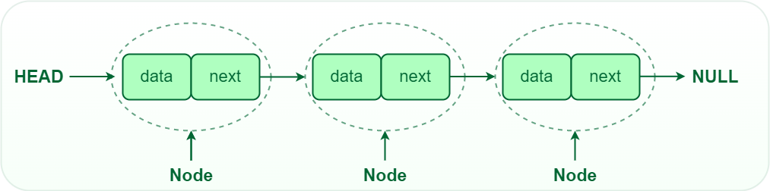
Linked Lists
A linked list is a linear data structure where elements, called nodes, are connected using pointers or references.
Each node contains data and a reference to the next node in the sequence.
Unlike arrays, linked lists do not require contiguous memory allocation.

Slide 25
Java.util.LinkedList
Implementation:
LinkedList is implemented as a series of nodes, where each node contains an element and references to next nodes in the list. This linked structure allows for efficient insertions and removals.
Ordered Collection:
Like all classes implementing the List interface, LinkedList maintains the order of elements in which they were added.
Dynamic Sizing:
Similar to ArrayList, LinkedList can dynamically resize itself to accommodate new elements.
Fast Insertions and Removals:
LinkedList excels at insertions and removals, especially at the beginning and end of the list. This is because only a few references need to be updated.

Slide 26
Java.util.LinkedList
Random Access:
Accessing elements by index in a LinkedList is less efficient than in an ArrayList due to the need to traverse the list from the beginning or end.
Duplicates Allowed:
LinkedList allows duplicate elements, just like other classes implementing the List interface.
Common Methods:
LinkedList includes methods inherited from the List interface, as well as from the Collection interface. Some commonly used methods include add(), remove(), get(), set(), size(), and more.
Iterating Through a LinkedList:
You can use iterators, enhanced for loops, or the Java 8 Stream API to iterate through the elements of a LinkedList.
Comparing to ArrayList:
LinkedList is generally better for frequent insertions/removals, especially near the beginning or end of the list.
ArrayList is generally better for random access, as elements can be accessed directly by index.

Slide 27
Anatomy and Features of LinkedList
Internal Structure:
In a LinkedList, each element is represented by a node. Each node contains two parts
Data: The actual value you want to store.
Next Reference: A reference to the next node in the sequence. The last node's "next" reference points to null, indicating the end of the list.
Features of LinkedList:
Dynamic Size: LinkedList is a dynamic data structure, meaning it can grow or shrink as needed. Elements can be added or removed without requiring a fixed size.
Node-based Structure: Unlike arrays, which store elements in contiguous memory locations, LinkedList stores elements as nodes. Each node holds the data and a reference to the next node in the sequence.
Fast Insertions and Deletions: Insertions and deletions are faster in LinkedList compared to arrays, especially when they occur at the beginning or in the middle of the list. This is because shifting elements is not necessary.
Variable Access Time: Accessing elements in LinkedList can be slower than in arrays, particularly when accessing elements randomly. This is because you must traverse the list sequentially from the head to the desired element.

Slide 28
Types of LinkedList
Singly Linked List: Each node points only to the next node in the list.
Doubly Linked List: Nodes possess references to both the next and the previous nodes.
Circular Linked List: The last node points back to the first node, creating a circular structure.

Slide 29
Working with Linked Lists
Insertion
Insertion into a linked list involves creating a new node and updating pointers accordingly:
Insertion at the Beginning: Point the new node's "next" to the current first node, and update the header (if used).
Insertion at the End: Traverse to the last node, update its "next" to point to the new node.
Insertion in the Middle: Adjust the pointers of the preceding and succeeding nodes accordingly.
Deletion
Deletion requires modifying pointers to bypass the node being removed:
Deletion at the Beginning: Update the header (if used) and point it to the next node.
Deletion at the End: Traverse to the second-to-last node, update its "next" to null.
Deletion in the Middle: Adjust pointers of preceding and succeeding nodes to bypass the node being deleted.
Traversal
Traversing a linked list involves following the chain of nodes sequentially:
Using a While Loop: Initialize a pointer at the head, traverse until null is reached.
Using For-Each Loop: Java's enhanced for loop simplifies iteration.

Slide 30
Linked List Operations
Insertion
add(element): This method appends an element to the end of the LinkedList.
addFirst(element): Here, an element is inserted at the beginning of the LinkedList.
addLast(element): This method adds an element to the end of the LinkedList.
Traversal
Enhanced for loop: This loop efficiently traverses the LinkedList, allowing us to process each element.
for (DataType item : linkedList) {
// Process each item
}
Deletion
remove(): Deletes the first element from the LinkedList.
remove(element): If found, this method removes a specific element from the LinkedList.
removeFirst(): Removes the first element from the LinkedList.
removeLast(): Eliminates the last element from the LinkedList.

Slide 31
LinkedList Hands-On

Slide 32
ArrayList vs LinkedList
 | ArrayList | LinkedList
1. | This class uses a dynamic array to store the elements in it. With the introduction of generics, this class supports the storage of all types of objects. | This class uses a doubly linked list to store the elements in it. Similar to the ArrayList, this class also supports the storage of all types of objects.
2. | Manipulating ArrayList takes more time due to the internal implementation. Whenever we remove an element, internally, the array is traversed, and the memory bits are shifted. | Manipulating LinkedList takes less time compared to ArrayList because, in a doubly-linked list, there is no concept of shifting the memory bits. The list is traversed, and the reference link is changed.
3. | Inefficient memory utilization. | Good memory utilization.
4. | It can be one, two or multi-dimensional. | It can either be single, double or circular LinkedList.
5. | Insertion operation is slow. | Insertion operation is fast.
6. | This class implements a List interface. Therefore, this acts as a list. | This class implements both the List interface and the Deque interface. Therefore, it can act as a list and a deque.
7. | This class works better when the application demands storing the data and accessing it. | This class works better when the application demands manipulation of the stored data.
8. | Data access and storage is very efficient as it stores the elements according to the indexes. | Data access and storage is slow in LinkedList.
9. | Deletion operation is not very efficient. | Deletion operation is very efficient.
10. | It is used to store only similar types of data. | It is used to store any types of data.
11. | Less memory is used. | More memory is used.
12. | The memory is allocated at compile-time only. | The memory is allocated at run-time.
13. | This is known as static memory allocation. | This is known as dynamic memory allocation.

Slide 33
Set Interface

Slide 34
Java.util.Set
In Java, the Set interface is a part of the Java Collections Framework and represents a collection that does not allow duplicate elements.
The Java Collections Framework includes several classes that implement the Set interface, such as HashSet, LinkedHashSet, and TreeSet.
No Duplicate Elements: A Set does not allow duplicate elements. Each element in a Set must be unique based on the element's equals() method.
Unordered Collection: The elements in a Set are not stored in a specific order, unlike a List or an array. The order of elements may vary depending on the specific implementation.
Implements Collection: The Set interface extends the Collection interface, which means that it inherits the methods defined in Collection. This includes methods for adding, removing, querying, and manipulating elements.
Common Methods:The Set interface defines common methods such as add(), remove(), contains(), size(), and more. These methods are used for working with elements in the set.

Slide 35
Java.util.Set
Subinterfaces and Implementations:
Some common implementations include:
HashSet: Uses a hash table for fast insertion, deletion, and retrieval of elements. Does not guarantee order.
LinkedHashSet: Maintains the insertion order of elements while offering fast retrieval.
TreeSet: Maintains elements in sorted order. Implements a self-balancing binary search tree.
Null Elements: Most Set implementations do not allow null elements. However, some implementations like HashSet allow a single null element.
Use Cases: Set implementations are useful in scenarios where you need to store a collection of elements without duplicates. They are suitable for tasks such as maintaining a list of unique items, checking membership, and ensuring data integrity.

Slide 36
Implementation of Set Interface
HashSet:
Implemented using a hash table.
Offers constant-time performance for basic operations (add, remove, contains).
Does not guarantee order of elements. Allows a single null element.
Well-suited for scenarios where you need a fast and efficient set of unique elements.
Example: Removing duplicates from a collection.
LinkedHashSet:
Implemented as a hash table with a linked list running through it.
Maintains the insertion order of elements.
Offers constant-time performance for basic operations.
Useful when you want to maintain insertion order while still having fast access.
TreeSet:
Implemented as a self-balancing binary search tree (Red-Black Tree).
Maintains elements in sorted order.
Offers logarithmic-time performance for most operations.
Supports methods for retrieving subsets of elements based on ranges.
Suitable for scenarios where you need elements to be sorted and ordered.
Example: Maintaining a sorted set of timestamps.

Slide 37
Set Hands-on

Slide 38
Interview Questions

Slide 39
ArrayList Interview Questions
What is an ArrayList in Java?
How is an ArrayList different from an array?
How do you create an ArrayList?
How can you add elements to an ArrayList?
How can you remove elements from an ArrayList?
How do you access an element at a specific index in an ArrayList?
How would you iterate through the elements of an ArrayList?
What method would you use to find the number of elements in an ArrayList?
How do you check if an ArrayList contains a certain element?
How do you clear all elements from an ArrayList?

Slide 40
ArrayList Interview Questions
Explain the concept of dynamic resizing in an ArrayList.
What's the difference between the capacity and size of an ArrayList?
Can you store primitive data types directly in an ArrayList?
What's the time complexity of adding an element to the end of an ArrayList?
How can you sort the elements in an ArrayList?
What happens if you try to access an index that's out of bounds in an ArrayList?
How can you replace an element at a specific index in an ArrayList?
What's the purpose of the ensureCapacity() method in ArrayList?
How can you convert an ArrayList to an array?
Explain the concept of an iterator and how it's used with an ArrayList.

Slide 41
Linked List Interview Questions
What is a LinkedList in Java and how does it differ from an ArrayList?
Explain the difference between a singly-linked list and a doubly-linked list.
When is a LinkedList preferred over an ArrayList, and vice versa?
What is the time complexity for adding, retrieving, and removing elements in a LinkedList?
How do you perform insertion and deletion of elements at the beginning and end of a LinkedList?
How does a LinkedList handle dynamic resizing compared to an ArrayList?
What is the role of the Node class in implementing a LinkedList?
How does a LinkedList traverse its elements compared to an ArrayList?
Explain the concept of a circular linked list and its use cases.
What is the significance of the removeFirst and removeLast methods in LinkedList?

Slide 42
Linked List Interview Questions
When and why would you use the offer, poll, and peek methods in a LinkedList?
How does a LinkedList handle memory compared to an ArrayList?
What are the potential drawbacks of using a LinkedList in terms of memory overhead?
How does a LinkedList handle concurrent access in a multi-threaded environment?
Explain the benefits and drawbacks of using the subList method in LinkedList.
What is the difference between an Iterator and a ListIterator in a LinkedList?
How can you reverse the elements of a LinkedList without using additional data structures?
When and why would you encounter a NullPointerException in a LinkedList?
What is the main difference between a Stack and a LinkedList in terms of implementation?
How would you implement a custom queue using a LinkedList in Java?

Slide 43
Assignments

Slide 44
ArrayList Assignments
Assignment 1: Grocery List Create a simple grocery list program using an ArrayList. Allow users to add items to the list and display the final list of items.
Assignment 2: Number Sorter Write a program that takes a list of numbers as input and uses an ArrayList to sort and display them in ascending order.
Assignment 3: String Reversal Develop a program that takes a string input and uses an ArrayList to reverse and display the characters of the string.
Assignment 4: Even-Odd Separator Create a program that takes a list of numbers as input and uses an ArrayList to separate even and odd numbers into two separate lists.
Assignment 5: Vowel Counter Write a program that takes a string as input and uses an ArrayList to count and display the number of occurrences of each vowel (a, e, i, o, u).

Slide 45
Linked List Assignments
Assignment 1: Implement a To-Do List Application
Create a To-Do List application where users can add, remove, and mark tasks as completed. Use a LinkedList to store the tasks and implement methods to perform these operations. You can also add features like sorting tasks based on priority or due date.
Assignment 2: Simulate a Train Queue
Develop a simulation of a train queue where passengers can join the queue, board the train, and leave the queue once they board. Use a LinkedList to manage the queue of passengers. Implement methods to add passengers, board the train, and display the current status of the queue.
Assignment 3: Building a Text Editor
Create a simple text editor that allows users to insert, delete, and edit characters within a text. Use a LinkedList to represent the text content. Implement methods for inserting characters at specific positions, deleting characters, and undoing changes.
Assignment 4: Music Playlist Shuffle
Build a music playlist application where users can create playlists and shuffle the order of songs. Use a LinkedList to represent the playlist. Implement methods to add songs, shuffle the playlist, and play songs in order.

Slide 46
Q&A

